Slide 1


VISUALIZATION MODELS

Slide 2
MANUAL TO USE LIFECYCLE MODEL
  →CHOOSE VISUALIZATION IN TOP BANNER
    STATIC SUMMARY
    SUNBURST
    ICICLE
    TREE
    CIRCLES
    TABLE
    FULL TABLE EXPORT
  →FILTER REQUIREMENTS IN THE LEFT BANNER
  1. FILTER BASED ON RELEVANT PHASE TO EXAMINE
  2. SELECT CLASS OF REQUIREMENT
  3. SELECT REQUIRMENTS BY NUMBERS
  4. SELECT REQUIREMENTS IN TEXT
  5. VIEW DATA ACCORDING TO CONTEXT
  → DOWNLOAD SELECTED DATA in CSV FORMAT

Slide 3
Context of 4 life cycle steps in 2030 and
3 main purposes across → 75+ requirements to discuss and validate
2
4
Digital asset management
content
Distribution and usage
8 RMI, 1 T&T
14 RMI, 7 T&T
1
Media asset creation
asset identifiers
12 RMI, 9 T&T
3
agent
identifiers
Metadata management
provenance, authenticity,
attribution, usage T&Cs including AI-related reservations such as opt-out expressions
National libraries mandates
interoperable,
trustworthy,
Commercial licensing
machine-readable metadata
Search across existing repositories
22 RMI, 3 T&T
56 requirements related to rights management information (RMI)
21 requirements related to traceability and transparency (T&T)
15

Slide 4
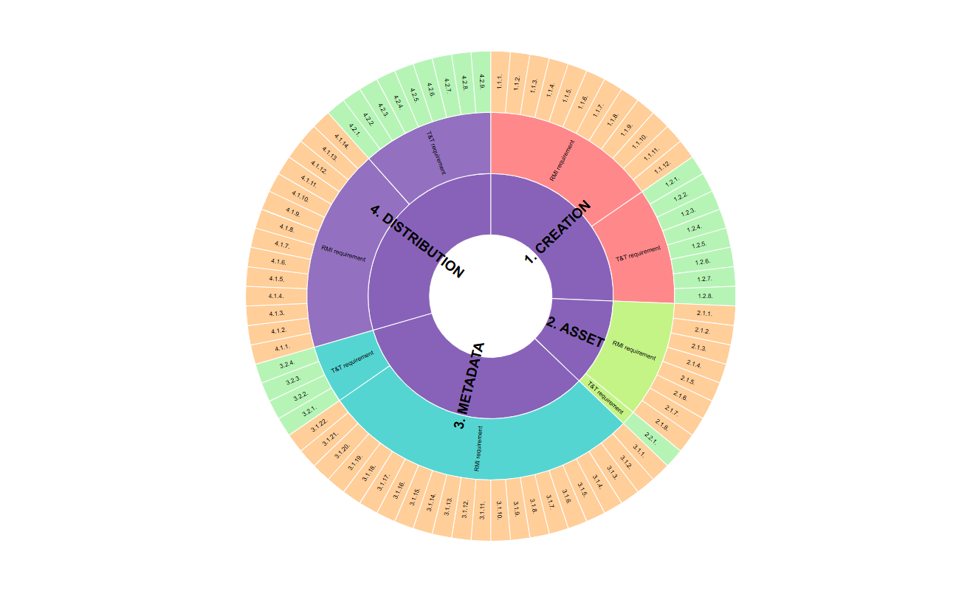
SUNBURST

Slide 5
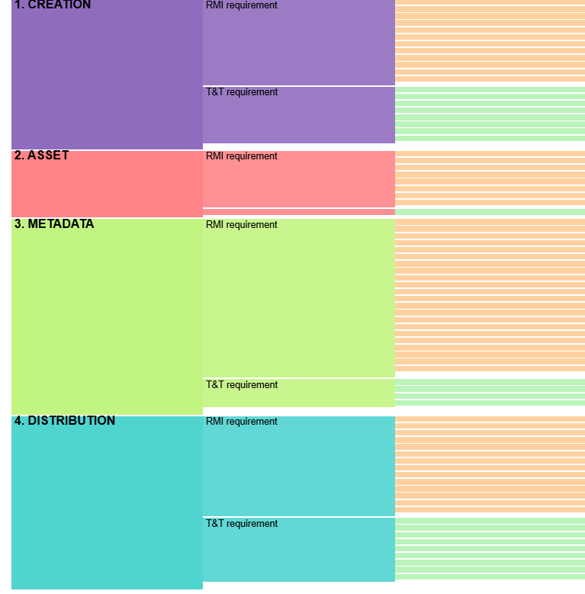
ICICLE

Slide 6
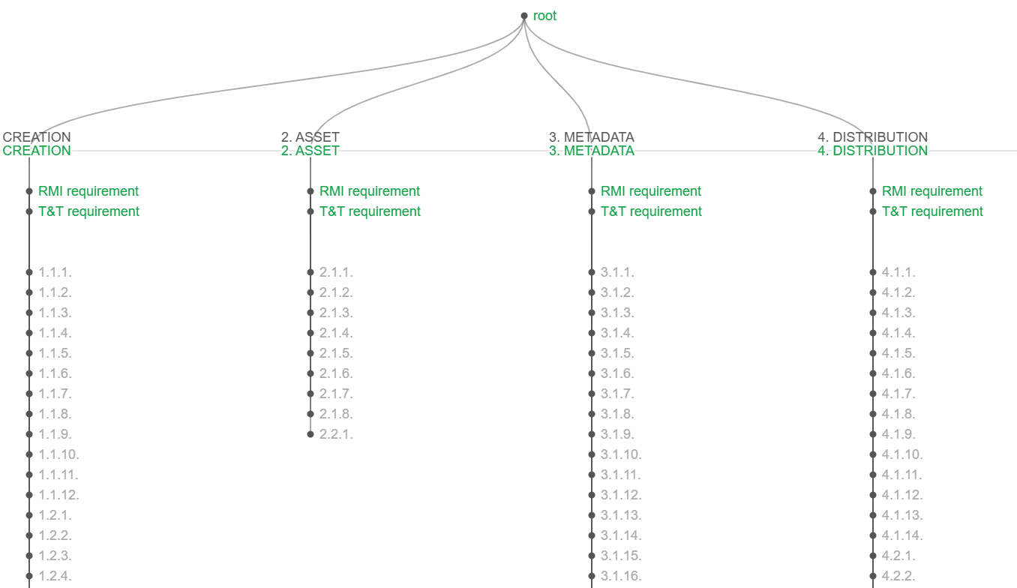
TREE

Slide 7
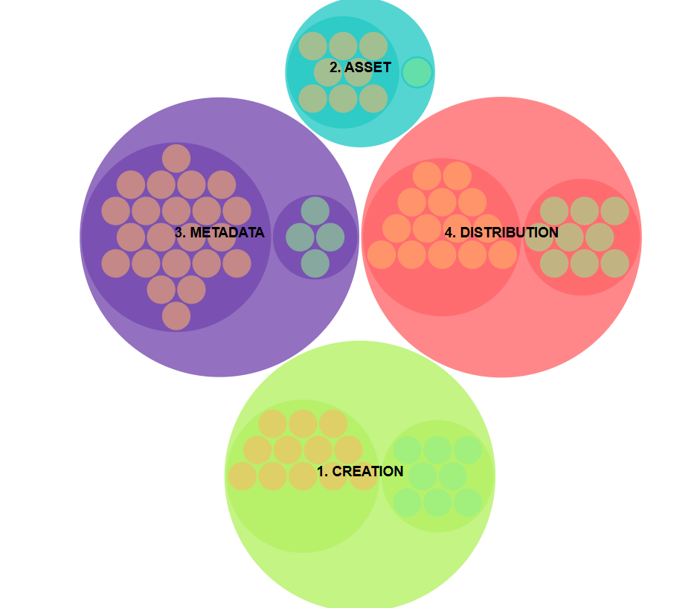
CIRCLES

Slide 8
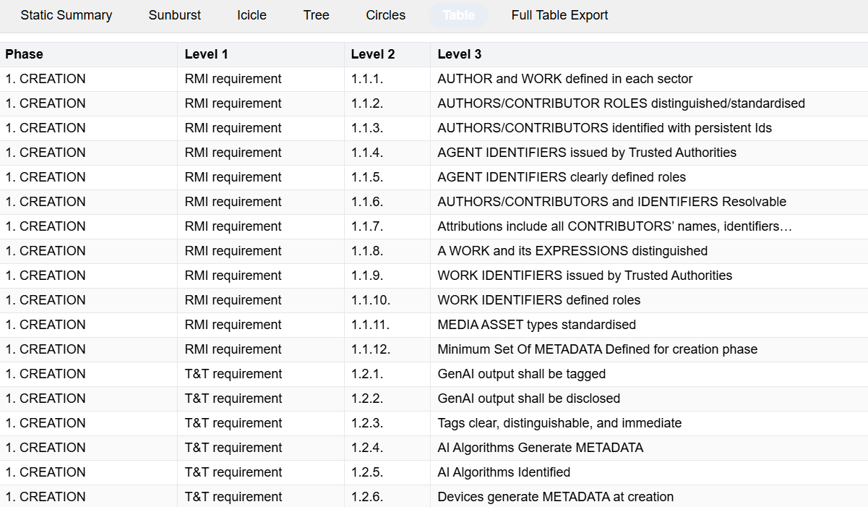
TABLE

Slide 9
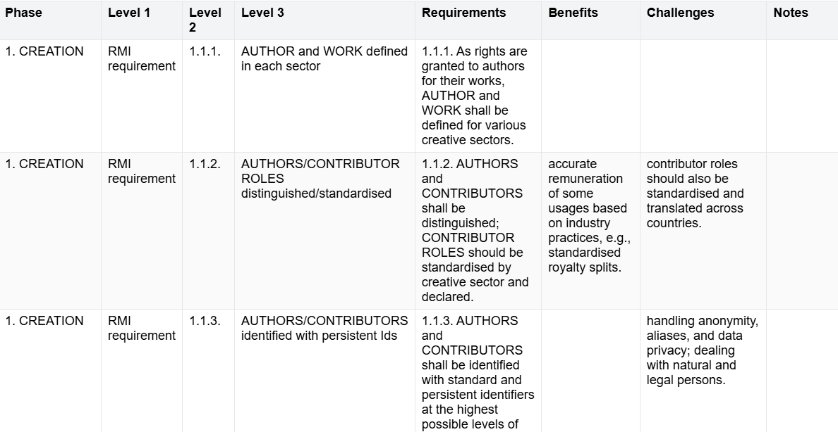
FULL TEXT TABLE

